Slide 1

EventriumDB – EVENT MANAGEMENT DATABASE
PRESENTER: LAKSHMI MOUNIKA B

Slide 2
PURPOSE OF THE NARRATIVE
PROBLEM STATEMENT: The current event management process in Eventrium faces inefficiencies and hurdles due to decentralized data sources, manual procedures, and an absence of centralized information. Important aspects like choosing venues, allocating staff, handling invoices, and analyzing performance are impeded by the lack of a cohesive platform. This fragmentation leads to heightened expenses, inefficient use of resources, invoicing inaccuracies, and a deficit of valuable insights for future event planning.
SOLUTION: To address these challenges, we propose creating a centralized event database ‘EventriumDB’ to connect all functions - concepting, planning, scheduling, invoicing. Structured information on events, venues, staff will increase efficiency. Detailed tracking of bookings, billing and payments will reduce errors.

Slide 3
USERS & INFORMATION NEEDS
EVENT PLANNERS AND ORGANIZERS:
EVENT DETAILS
VENUE INFORMATION
ORGANIZER AND CLIENT INFORMTION
FINANCIAL STAFF:
INVOICE DETAILS
PAYMENT AND REFUND INFORMATION
QUOTE DETAILS
STAFF MANAGEMENT:
STAFF DETAILS
STAFF ROLES AND RESPONSIBILITIES
STAFF RATES AND EXPERIENCE
QUOTE AND PACKAGE MANAGEMENT:
QUOTE DETAILS
PACKAGE OFFERINGS

Slide 4
USER APPLICATIONS
PLAN EVENTS
BOOKINGS & PACKAGES
FINANCIAL MANAGEMENT
CLIENT AND STAFF MANAGEMENT

Slide 5
KEY ENTITIES
EVENT Table: Captures details about events, including event ID, name, description, dates, venue, organizer, and status.
VENUE Table: Stores information about event venues, such as venue ID, name, address, capacity, and amenities.
ORGANIZER Table: Contains details about event organizers, including organizer ID, name, contact information, and website.
CLIENT Table: Manages information about clients, including client ID, name, contact details, and company information.
BOOKING Table: Tracks event bookings with details like booking ID, event ID, client ID, booking date, and status.
PACKAGE Table: Contains information about event packages, including package ID, name, description, and price.
STAFF Table: Stores details about event staff, including staff ID, name, contact information, role, and type.
INVOICE Table: Manages invoicing information, including invoice ID, booking ID, amount, date, and payment status.
PAYMENT Table: Tracks payment details, including payment ID, invoice ID, amount, date, and payment method.
REFUND Table: Manages refund transactions, including refund ID, payment ID, refund amount, and date.
QUOTE Table: Stores information about quotes, including quote ID, client ID, event ID, quote amount, and date.
REGULAR_STAFF and MANAGERIAL_STAFF Tables: Capture details about regular and managerial staff, including staff ID, rates, and experience.

Slide 6
DATA TYPES
VARCHAR (Variable character)
VARCHAR (Numeric with Alphanumeric Character)
VARCHAR (Email and URLs)
VARCHAR (Phone Number)
VARCHAR (Postal code)
VARCHAR (Status)
CHAR (Character)
DATE
DECIMAL (Numeric with Decimal Point)
INT (Integer)

Slide 7
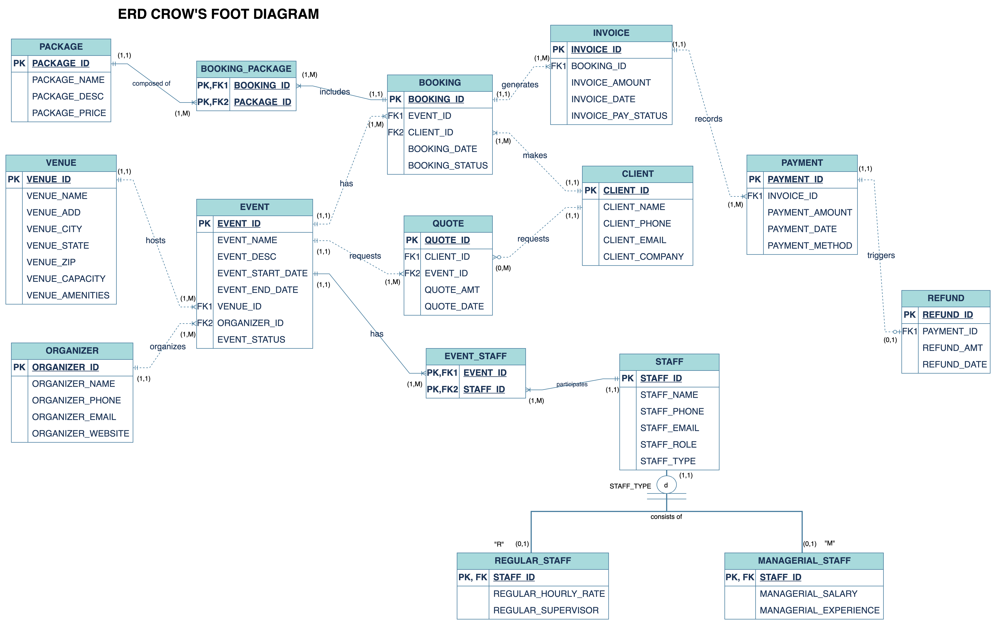
ERD DIAGRAM

Slide 8
CHALLENGES
Normalization Challenges:
Challenge: Achieving the right level of normalization without overcomplicating the schema.
Solution: Conduct a thorough analysis of the data to identify and eliminate redundancy. Balance the normalization level to ensure data integrity while avoiding unnecessary complexity.
Complex Relationships:
Challenge: Managing complex relationships between entities (events, venues, organizers, clients, staff).
Solution: Clearly define relationships, use foreign keys appropriately, and avoid circular dependencies. Create an Entity-Relationship Diagram (ERD) to visualize and validate relationships.
Data Integrity Concerns:
Challenge: Enforcing data integrity constraints in a system with interconnected data.
Solution: Use foreign key constraints, unique constraints, and check constraints to ensure data integrity. Regularly perform data validation and quality checks to identify and rectify inconsistencies.

Slide 9
LEARNINGS
Comprehensive Design:
The databook emphasizes the importance of creating a thorough data model covering all aspects of event management, ensuring the database meets diverse stakeholder needs.
Normalization Efficiency:
Achieving optimal normalization is crucial for reducing redundancy, ensuring efficient data storage, and minimizing the risk of anomalies.
Clear Entity Relationships:
Well-defined relationships between entities contribute to a successful database by enhancing understanding and facilitating effective communication among users and developers.
Flexibility for Future Changes:
Designing the database with flexibility allows seamless integration of new features and adaptations to evolving requirements without extensive restructuring.
Data Integrity and Constraints:
Ensuring data integrity through foreign key, unique, and check constraints, along with regular data validation checks, is essential for maintaining the reliability of the database.

Slide 10
INSIGHTS FOR FUTURE PROJECTS
Plan for extensibility during modeling phases: Keeping future growth in mind for entities and associating fields for additional attributes can minimize rework.
Build physical schemas in phases: Rather than target the full model in one shot, iterate on high priority entities and relationships first. Seek periodic feedback.
Establish a structured design process: Consistently follow steps around business rules definition, ERD diagrams, normalization etc. irrespective of project size helps streamline development.
Understand implicit relationships: Beyond explicit associations, analyze if there are potential connections like event to invoice that warrant capture via foreign key links for usability.
Gather requirements from diverse users: Managing events involves roles like planners, finance, sales - each may have unique needs. Multi-perspective analysis prevents gaps.
Validate business rules via multiple scenarios: Corroborate the defined entity level rules with real-world use cases through examples to confirm robustness.

Slide 11
THANK YOU
ANY QUESTIONS?

